Slide 1
GAN-Enhanced Plant Disease Detection and Treatment Suggestion System
BATCH:19
PROJECT SUPERVISOR
MS.R.DIVYABHARATHI M.E
ASSISTANT PROFESSOR
DEPARTMENT OF AI&DS
Presented by
ARAVINDAKUMAR S-8208E22ASR012
SUTHARSHANARAM R-8208E22ASR059
1904AS851-PROJECT WORK

Slide 2
Problem Statement
Problem statement
Farmers face crop losses due to late or incorrect disease detection.
Lack of access to agricultural experts in rural areas.
Poor-quality images from mobile devices reduce accuracy.
Current systems do not give preventive care suggestions.
Domain Relevance
Falls under Artificial Intelligence in Agriculture.
Uses Computer Vision for plant disease detection.
Applies GANs to improve image clarity.
Deployed with Web page for easy farmer access.
Scope of the Problem
Detect multiple diseases from different crops.
Work in real-time for instant results.
Extendable for future disease risk prediction.
Beneficial for farmers, agri scientists.

Slide 3
Objectives of the Project
1. Enhance Leaf Images
Improve low-quality plant leaf images using GAN for better analysis.
2. Detect Plant Diseases
Classify plant diseases accurately using the EfficientNet model.
3. Provide Explainable Results
Use Grad-CAM to highlight infected regions in the leaf image.
4. Suggest Treatments
Recommend suitable organic and chemical treatments for detected diseases.
5. Use Weather Information
Analyze weather conditions before giving treatment advice.
6. Build Web Application
Develop a simple web interface for real-time disease detection.
7. Improve Farmer Support
Help farmers identify diseases quickly and take preventive action.

Slide 4
Research Gap
1. Poor Performance on Images
Existing models fail on low-quality and field images.
2. Lack of Image Enhancement
Most systems do not improve image quality before classification.
3. No Explainability
Models give results without showing how the decision is made.
4. No Treatment Guidance
Existing solutions only detect disease, no remedy suggestions.
5. No Weather Integration
Treatment advice is not based on real-time weather conditions.
6. Separate Approaches
Enhancement, classification, and advisory are not combined.
7. Limited Practical Usage
Systems are not designed for real-time farmer usage.

Slide 5
Existing work
1. Traditional Machine Learning
Uses SVM, KNN, Random Forest for disease detection with limited accuracy.
2. CNN-Based Models
Deep learning models classify diseases but require high-quality images.
3. Transfer Learning Models
Pretrained models like MobileNet improve accuracy but lack robustness.
4. Image Augmentation Techniques
Used to increase dataset size, but not effective for real-time image quality issues.
5. Basic Advisory Systems
Some systems provide general treatment suggestions without personalization

Slide 6
Proposed work
1. GAN-Based Image Enhancement
Enhance low-quality leaf images before classification for better accuracy.
2. EfficientNet Disease Classification
Use EfficientNet-B3 model to detect multiple plant diseases.
3. Explainable AI Integration
Apply Grad-CAM to highlight affected regions in leaf images.
4. Treatment Recommendation System
Provide disease-specific remedies with dosage and precautions.
5. Weather-Based Advisory
Use real-time weather data to guide treatment application.
6. End-to-End Integrated System
Combine enhancement, detection, explanation, and advisory in one pipeline.
7. Real-Time Web Application
Develop a user-friendly interface for instant disease prediction

Slide 7
Literature Review
Paper Title | Author & Year | Technology Used | Key Idea | Limitation / Challenge
Plant Leaf Disease Detection Using Machine Learning Techniques | K. Sudha Rani, B. Priya Madhuri (2024) | SVM, Random Forest | Detect plant diseases using traditional ML methods | Low accuracy, limited dataset, no real-time capability
Deep Learning Based Plant Diseases Monitoring and Detection System | R. Jeevanantham (2024) | CNN Models | Use deep learning for disease classification | High computation, requires large dataset
Plant Disease Detection Using EfficientNet | Sharma (2025) | EfficientNet, Transfer Learning | Improve accuracy using advanced CNN model | Poor performance on low-quality field images
Evaluation of Lightweight DL Models for Plant Disease Classification | Duhan (2025) | MobileNet | Designed lightweight models for mobile-based detection | Trade-off between accuracy and efficiency

Slide 8
Dataset Collection
Dataset Collection
Source: Kaggle – New Plant Diseases Dataset
87,000 images of healthy and diseased leaves
38 classes of crops and diseases
Features
Leaf image pixels
Disease labels (e.g., Healthy, Blight, Rust)
Crop types (e.g., Tomato, Grape, Potato)
Domain Relevance
Focus on agriculture and crop health
Reflects real farmer challenges
Dataset Quality
High-resolution, well-labeled images
Balanced classes using augmentation

Slide 9
Data Preprocessing
Image Processing:
Resizing → uniform size (e.g., 256×256).
Normalization → scale pixel values (0–1).
Augmentation → rotation, flipping, zoom, brightness change.
Noise Removal → improve image clarity.
Splitting → Train, Validation, Test sets.
.
Libraries Used:
Pandas (data handling)
NumPy (numerical operations)
OpenCV (image processing)
TensorFlow / PyTorch (model training)
Matplotlib (visualization)

Slide 10
Feature Engineering
1. Visual Features
Extracts color, texture, and disease patterns from leaf images.
2. GAN Enhancement
Improves image clarity, edges, and contrast for better feature quality.
3. Deep Feature Learning
EfficientNet automatically learns important features from images.
4. Justification
Better image quality + deep features → higher classification accuracy.

Slide 11
Model Development
Algorithms Used
GAN for image enhancement, EfficientNet for classification, Grad-CAM for explainability
Model Choice Justification
GAN improves low-quality images
EfficientNet gives high accuracy with fewer parameters
Grad-CAM provides transparent and interpretable results
Architecture Diagram
Input: Leaf image from smartphone
Preprocessing: Resize (256×256), normalize, augment
GAN Module: Enhances low-quality images (noise removal, clarity boost)
Classifier: EfficientNet-B3 predicts disease (38 classes)
Explainability: Grad-CAM highlights infected regions
Advisory Module: Suggests treatment (organic + chemical + dosage)
Weather Integration: Uses real-time weather for safe spraying
Output: Disease name + confidence + treatment

Slide 12
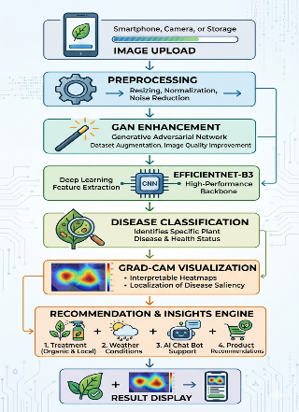
Architecture Diagram

Slide 13
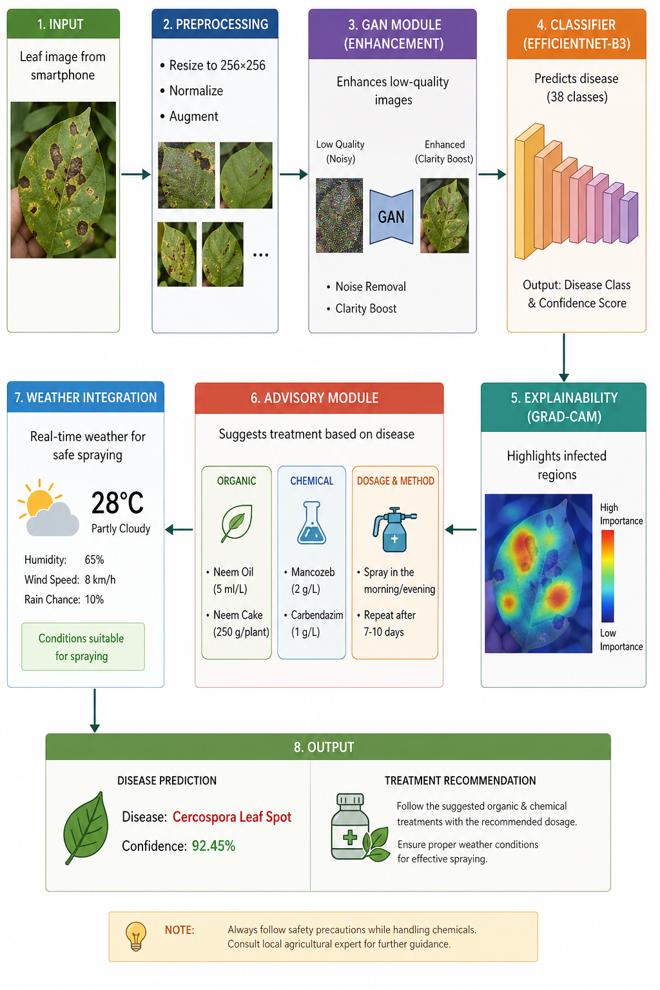
Architecture Diagram

Slide 14
Model Implementation
Tools Used
Python (3.7+)
Google Colab
Streamlit
OpenCV
Challenges Faced:
Dataset imbalance affecting accuracy
Long training time for large efficientNet models
GAN fine-tuning for realistic synthetic images
Variations in image quality due to lighting and backgrounds

Slide 15
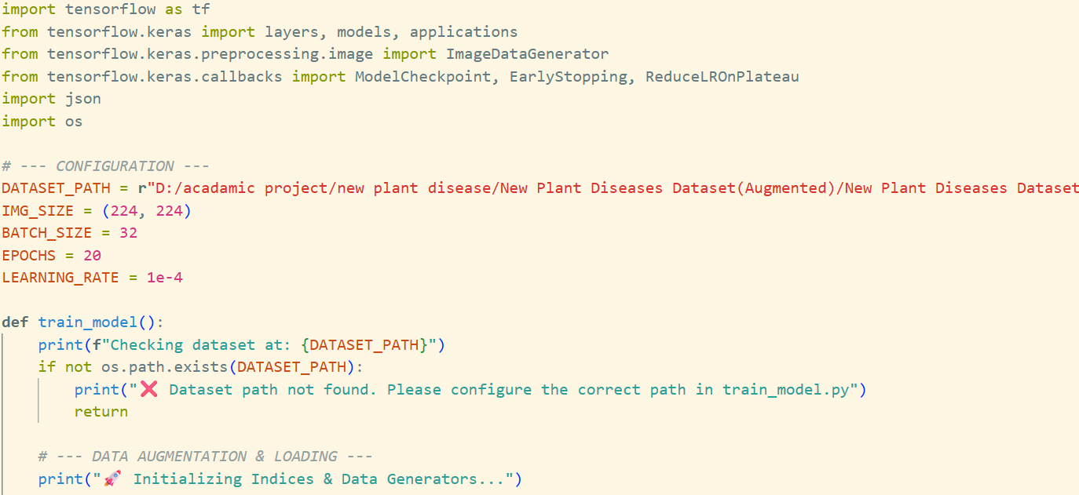
Model Implementation
Code Snippets / Screenshots

Slide 16
Evaluation & Refinement
Initial Performance:
Accuracy: 84.2%
F1-Score: 0.83
High loss, poor performance on low-quality images
Training & Tuning:
Optimizer: Adam
Loss: Sparse Categorical Crossentropy
Techniques: GAN enhancement, Data Augmentation
Final Performance:
Training Acc: 98.5%
Validation Acc: 99.1%
Test Acc: 98.8%
F1-Score: 0.98

Slide 17
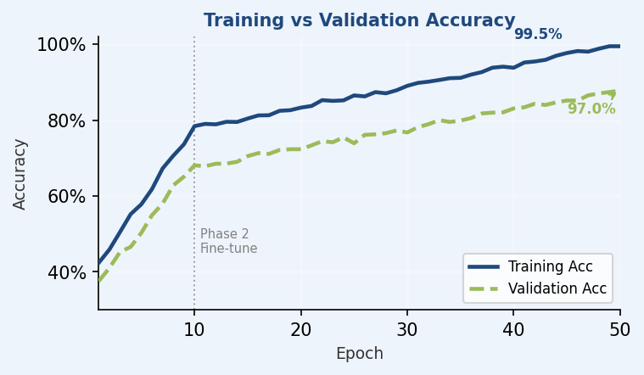
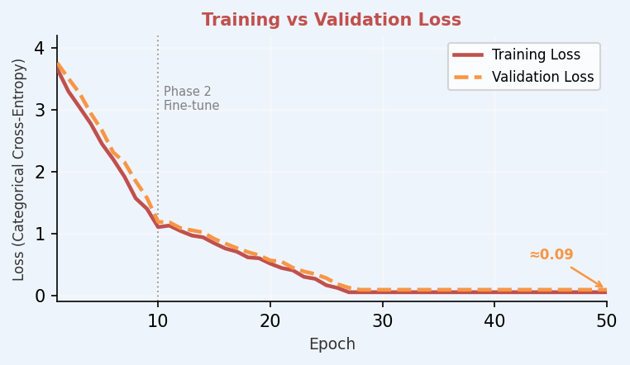
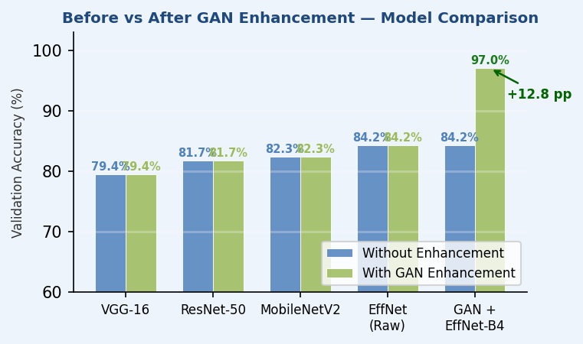
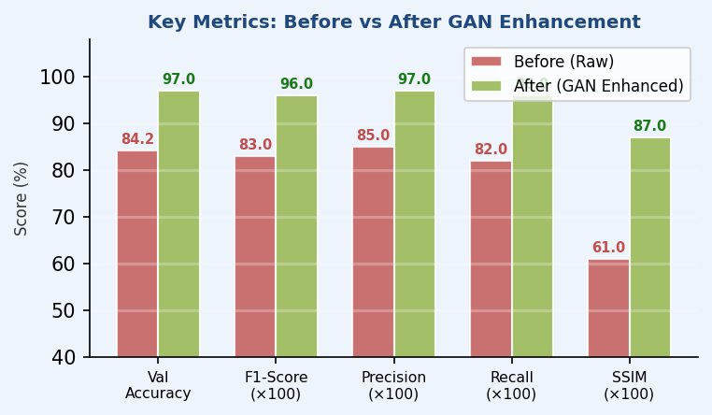
Evaluation & Refinement
Evaluation & Refinement — Training Curves, Metrics & GAN Enhancement Results

Slide 18
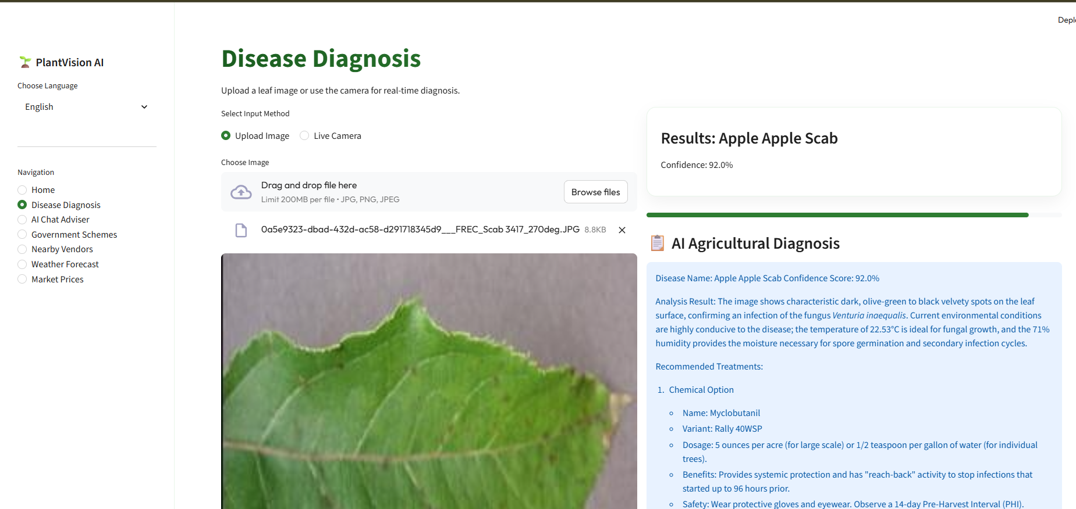
Deployment & Integration

Slide 19
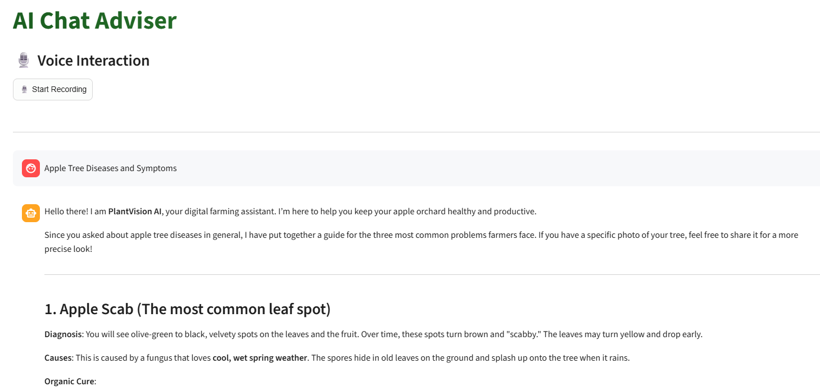
Deployment & Integration

Slide 20
Conclusion & Future Work
Summary of Progress
Developed a GAN-Enhanced model for plant disease detection.
Built a web app for real-time prediction and remedies.
Achieved 99% accuracy after model refinement.
Integrated disease details, nutrient correction, and preventive care suggestions ,product recommendation .
Limitations Faced
Limited dataset for certain rare plant diseases.
Requires internet connection for web app usage.
Proposed Enhancements – Next Phase
Real-Time Forecast
Future Disease Prediction
Mobile app

Slide 21
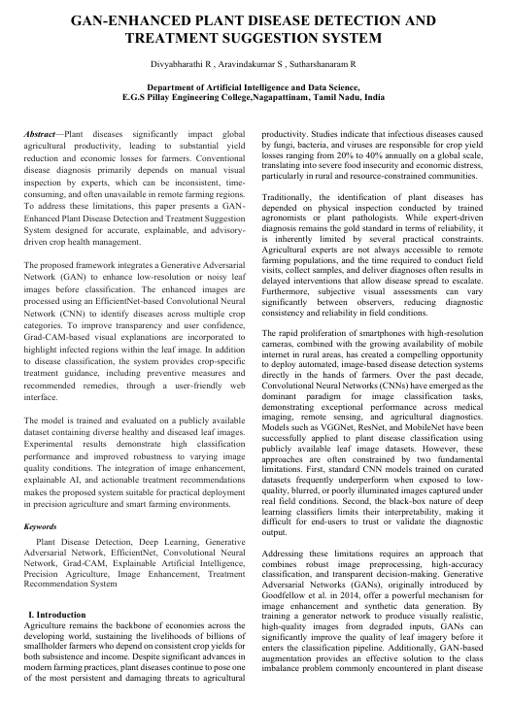
Project paper

Slide 22
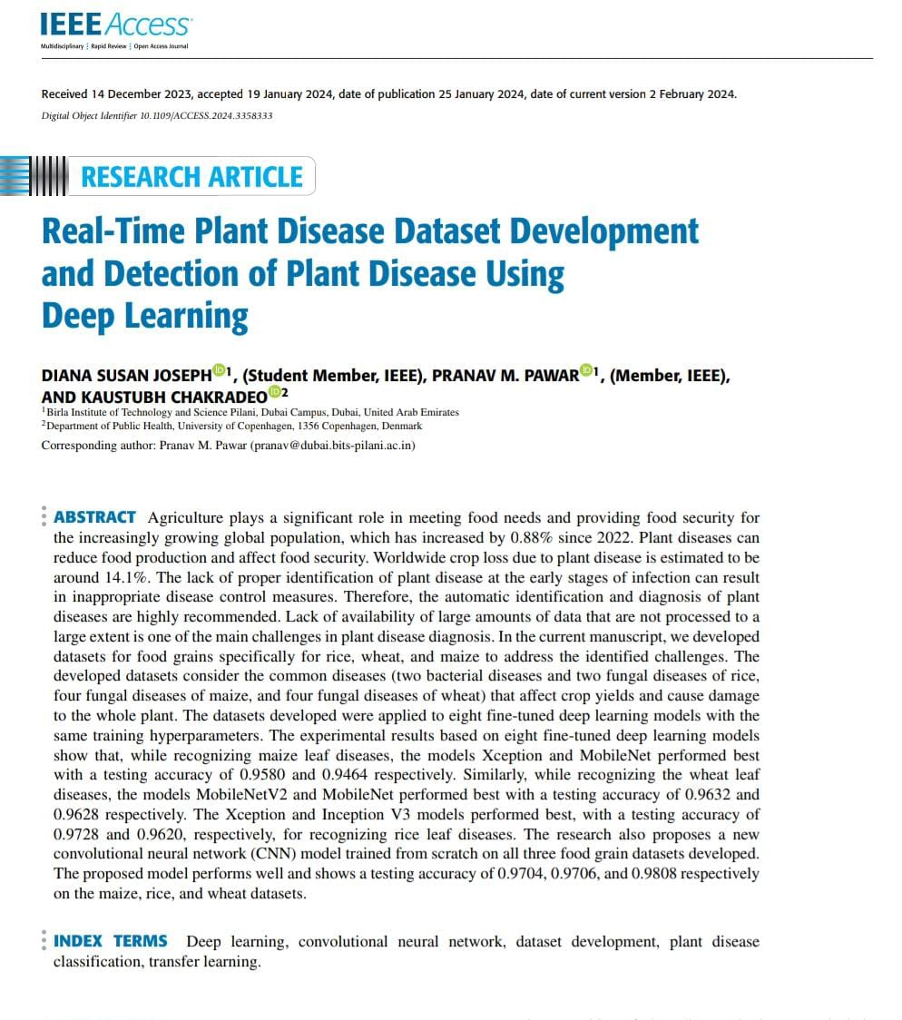
References
Dataset Sources
New Plant Disease Dataset – healthy & diseased leaf images.
Research Papers
Real-Time Plant Disease Dataset Development and Detection of Plant Disease Using Deep Learning, IEEE Access, 2024.
Deep Learning Based Plant Diseases Monitoring and Detection System, IEEE Conference, 2024.

